Slide 1
Business Continuity Planning for Hospitals
Jeremy Stacy

Slide 2
Objectives
Understand the steps in Business Continuity Planning.
Understand the terminology used in BCPs (RTO, RPO, etc.).
Describe the differences between Response actions and Recovery actions.
Understand why Business Continuity Planning is important.

Slide 3
Why perform business continuity planning?
Business Continuity Planning for Hospitals

Slide 4
Why?
HIPAA
164.308(a)(7)(ii)(A) – Data Backup Plan
164.308(a)(7)(ii)(B) – Disaster Recovery Plan
164.308(a)(7)(ii)(C) – Emergency Mode Operations Plan
164.308(a)(7)(ii)(D) – Testing & Revision Procedure
164.308(a)(7)(ii)(E) – Applications and Data Criticality Assessment

Slide 5
Why?
IM.01.01.03
The organization plans for continuity of its information management processes.
1. The organization has a written plan for managing interruptions to its information processes.
The plan for managing interruptions to electronic information systems addresses the following:
2. Scheduled and unscheduled interruptions.
3. Training for staff and licensed independent practitioners on alternate procedures to follow when systems are unavailable.
4. Backup of the electronic information systems.

Slide 6
Why?
IM.01.01.03
5. The organization's plan for managing interruptions to electronic information systems is tested for effectiveness according to time frames defined by the organization.
6. The organization implements its plan for managing interruptions to information processes to maintain access to information needed for resident care, treatment, and services.

Slide 7
Why?
Title 22 - 22 CCR § 70746
(a) Each hospital shall develop a written plan to be used when a discontinuance or disruption of services occurs.

Slide 8
Why?
The average time period (days) to restore to normal operations is 45 days.
Source: BC Management BCM ROI Report and Event Impact Management Report.

Slide 9
Financial considerations
Business Continuity Planning for Hospitals

Slide 10
Financial Considerations
Who pays what?
FEMA – services rendered to address the disaster
Medicare/Medi-Cal/Pvt Insurance – services you provided outside the disaster
Business Interruption Insurance – services you were unable to provide because of the disaster

Slide 11
FEMA
PRIOR to a disaster
Have policies on tracking disaster-related costs
Establish baseline rate of utilization & labor expense (document it!)
Have at least 2 $0 cost centers for expense tracking
Drill tracking expenses

Slide 12
Medicare/Medi-Cal/Insurance
IT dependent
Cannot generate charge tickets without ADT system
Cannot perform electronic submittals of charge tickets
Fund transfers are electronic

Slide 13
Medicare/Medi-Cal/Insurance
At the onset of a disaster, you will have 2+ weeks of unpaid charges already submitted.
Medicare/Medi-Cal – Request advance payment based on charge history (PIP payments)
Medi-Cal – Request “Value of Claim” letter for use as collateral against emergency loan (if needed)
Pvt. Insurance – Speak with your larger volume payors now to determine process.

Slide 14
Business Interruption Insurance
NOT a substitute for BCP!
Often takes 72+ hours to kick in
Claim-filing time limits
Per-incident limits
May exclude loss of utilities if building undamaged
May only cover a percentage of lost profits
Solid BCP may lower premium rates

Slide 15
Developing the plan(s) - Groundwork
Business Continuity Planning for Hospitals

Slide 16
Planning Team
Executive Sponsor
Department Directors
BCP Management Team – IT, Risk, Facilities, Disaster Coordinator, etc
Internal Subject Matter Experts
Poll your staff to see who has experience with disasters – Northridge, San Francisco, LA riots, etc

Slide 17
Contracted Services
Several Departments that are critical to continuity may be outsourced:
Food Service
Environmental Services
Patient Transportation
Sterile Processing
Facilities & Engineering
IT

Slide 18
Contracted Services
To do:
Review contracts for “Acts of God” or “Catastrophe” clauses
Revise contracts to detail critical nature of continuity in disaster
Involve legal counsel
Integrate into BCP program as any other department
If possible, leverage the size of the outsourced entity to your advantage

Slide 19
Methodology
Organizational: One BCP for the entire organization
Good for small businesses or focused businesses.
Departmental: One BCP per department
Good for large organizations with several critical components.

Slide 20
Methodology
Perform a Risk Assessment
Perform a Business Impact Analysis
Design Response & Recovery Strategies
Develop & Distribute Plan
Test & Maintain Plan

Slide 21
Risk Assessment
Use hospital HVA
The HVA does not replace your need to do a Risk Assessment
That which impacts the hospital overall may have minimal impact on your department’s ability to function
Ex – a casualty surge will not affect IS the same way it affects the hospital

Slide 22
Risk Assessment
Take the threats from the HVA one-by-one and consider:
Speed of onset: sudden or gradual?
Forewarning: yes or no?
Preparedness of your critical vendors: prepared or unprepared?
Preparedness of your own staff: prepared or unprepared?

Slide 23
Business Impact Analysis
How would each threat affect your department in 3 ways:
How likely is the event?
How much impact would it have on your ability to operate?
How long would it impact your operation?
Rate each on a scale of 0-3, with 3 being highest/longest

Slide 24
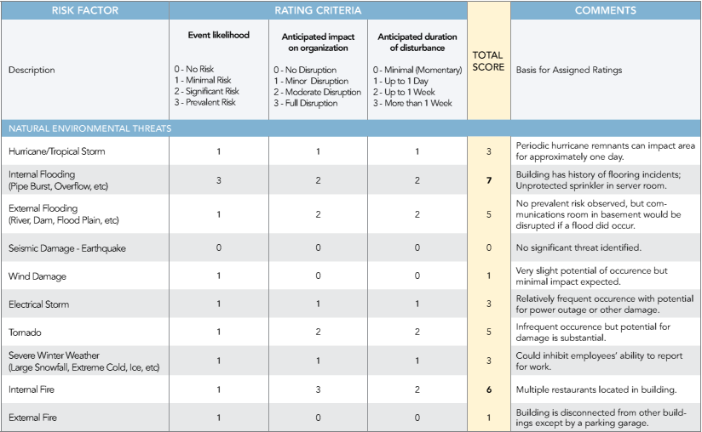
Business Impact Analysis

Slide 25
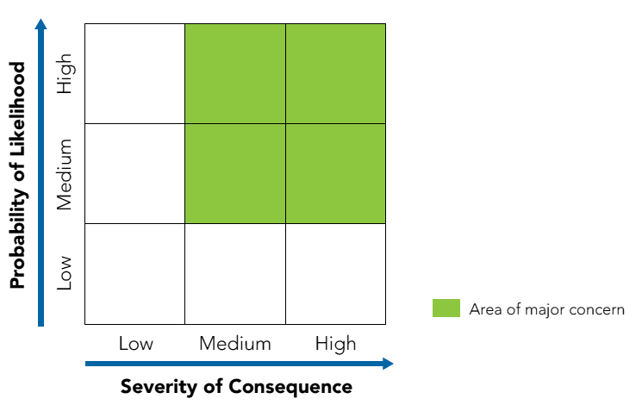
Business Impact Analysis

Slide 26
Business Impact Analysis
Probability
Severity

Slide 27
Business Impact Analysis
What are your critical business functions?
What are functions you perform to support other department’s critical business functions?
Resources needed
Impact on Safety/Operations
Financial impact
Customer/Reputation impact

Slide 28
Business Impact Analysis
Recovery Time Objective (RTO)
How long can the organization survive without your critical business function?
Current business day?
Tomorrow?
A week?
What resources are needed to ensure the restoration of the function within the RTO?

Slide 29
Business Impact Analysis
Recovery Point Objective (RPO)
For data-reliant processes, how current does the data need to be once systems are restored?
Last night’s backup?
Last transaction?
If you have a manual backup, how long is it feasible to run the manual backup before restoration is impossible?

Slide 30
Gap Analysis
Does your Facilities and IT staff have the resources to meet the RTO?
Does your IT department have the capability to meet the RPO?
What pre-planning can the department do to mitigate delayed response?
Pre-positioned supplies – go-bags and/or downtime kits
Pre-designated work areas

Slide 31
Impact Scenarios
Loss or denial of physical space
Your work area has been destroyed and/or become inaccessible.
Access to space, but loss of technology or utilities
Your area is intact, but without data/power/water/etc
Both

Slide 32
Impact Categories
Financial
The cost to recover all functions + loss of revenue
Ex: BP oil spill cost billions to clean + lost billions in product
Operational
The ability to physically execute a critical business function

Slide 33
Impact Categories
Legal/Regulatory
The ability to be fined, sued, or shut down.
Customer
The ability to retain customer base when operating in Emergency Mode
Reputation
The ability to retain customer base when the story gets out or recovery is complete
BCP can make or break market share

Slide 34
Developing the Plan(s) - Writing
Business Continuity Planning for Hospitals

Slide 35
Developing the BCP
Shoot for simple – your staff must be able to read, understand, and implement the plan under stressful conditions
A good plan doubles as a progress-monitoring tool for your recovery team
Plans should be organized so they are easy to follow from response to recovery
Write in plain language using only the amount of technical jargon needed.

Slide 36
Developing the BCP
“If you make something idiot-proof, they’ll make a better idiot.”

Slide 37
Basic Structure
Introduction
Overview
Scenarios
Response Team
Response Actions (Downtime Procedures)
Recovery Actions
Testing & Maintenance

Slide 38
Introduction
Straight-forward list of justifications (Purpose) and planning assumptions
Most BCPs are written for a worst-case scenario that involves multiple impact types

Slide 39
Overview
Identify Critical Business Functions
Identify RTO for each
Identify RPO for each (if applicable)
Identify Dependencies
Vital Records: records that must be restored
Critical Computer Applications: any applications that support Critical Business Functions

Slide 40
Scenarios
Response procedures for specific scenario types
Different from Downtime Procedures
How would this specific scenario impact your business area? Vs. How would you continue to perform your critical function?
Should be high-level, but still thought through

Slide 41
Loss of Work Area
Evacuation plan? Rally points?
What technology, utilities, equipment, size, etc. are needed to function?
Identify an alternate work area ahead of time
Can your critical functions be performed by staff from their homes?
If so, are they set up to do so?

Slide 42
Response Team
Detail Response Team members, leaders, and contact information.
Should have primary and alternate leaders
Always include a scribe role in your Response Team to document actions!
Identify critical vendors if they should be considered part of Response Team (i.e. data-recovery contractors).

Slide 43
Response Team
Don’t win the battle only to lose the war!
Staff:
Create teams by geographic region
Split teams into multiple, phased response groups
Split teams into continuity and response

Slide 44
Response Team
Disaster Response Team
Team members who will report directly to the frontline to assist with the disaster
Continuity Team
Team members who will stay behind to handle routine functions and/or workplace relocation
Know and drill your roles

Slide 45
Disaster Activation & Notification
What triggers your BCP?
How will staff be notified?
What is your staff’s expected response?
Does everyone report at once, or is there a first response team and a relief team?
Does anyone report in the middle of the night?
Downtime kits: Where are they? What’s in them?

Slide 46
Response Actions (Downtime Procedures)
Where the “rubber meets the road” of the plan
Highly specific depending on department and function
Should be written in a way that can be understood and managed by supervisor (consider checklists)
Should include vendor information, if not identified in Response Team

Slide 47
Response Actions (Downtime Procedures)
Dedicate 1 chapter to each Critical Business Function
If applicable:
How will you provide for current patients?
How will you provide for the triage area?
Documenting actions for patient charges is a response tactic, but processing payment charges is a recovery tactic.

Slide 48
Recovery Actions
Not the same as Response!
Response = what do we do now?
Recovery = how do we get back to normal?
Most steps should be your response in reverse
What systems/equipment need to be tested before returning to normal?
How will vital records be rebuilt?
Repatriation of work space.
Rebalance staff schedules.

Slide 49
Plan Testing & Maintenance
Orient staff to the BCP on hire
Incorporate knowledge of BCP into job description and evaluation
Test plan at least annually:
Tabletop with Response Team
Integrate into hospital-wide drill
Drill with dependent departments (IS, Facilities, etc)
Drill with critical vendors

Slide 50
Plan Testing & Maintenance
DOCUMENT orientations/drills, otherwise they didn’t happen
State where documentation is located – as an attachment, in staff mtg minutes, etc.
If drills lead to major revisions, document those revisions in the Plan Testing & Maintenance section
Note the last revision date and the next revision date

Slide 51
Questions?

